Slide 1

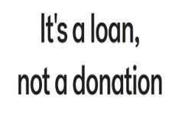
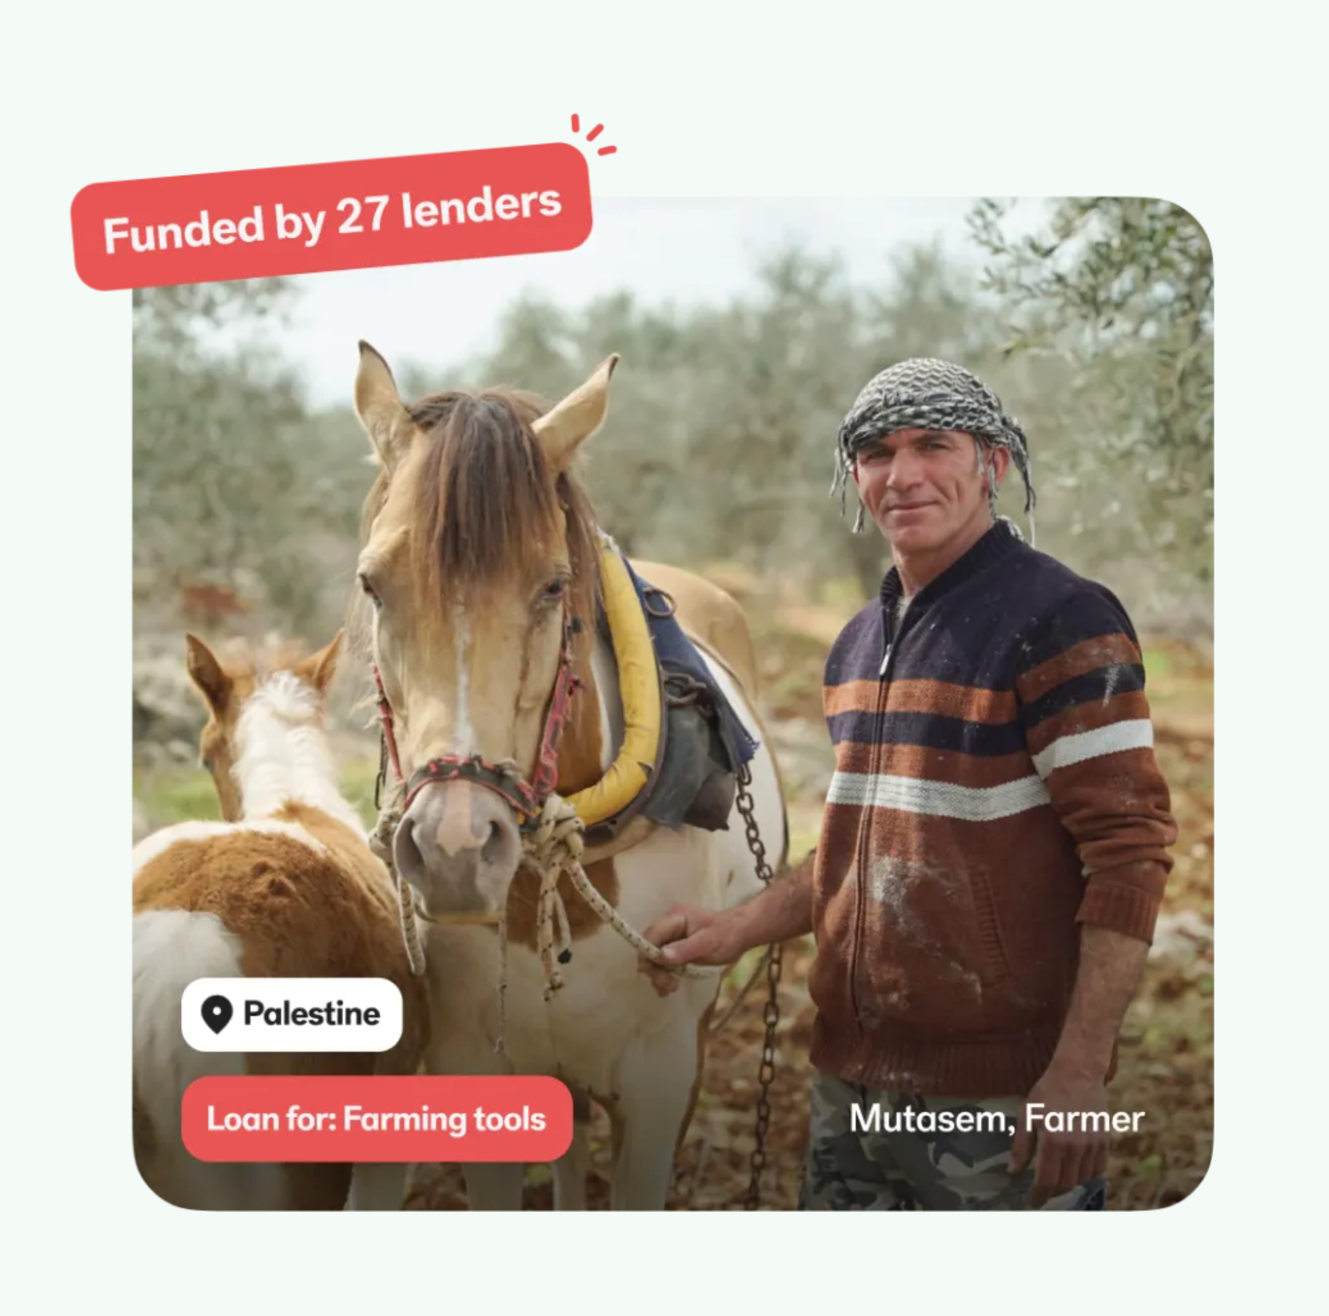
Team Eagles
PROJECT KIVA :
Examine Machine Learning applications on crowd empowered microfinance lending platform
Chethan Kumar Thimmaiah
Sai Deekshith Ratna
Vinay Vuppala
Omkar Vamsi Krishna Chinta
Leela Anjani Dwarampudi
https://www.youtube.com/watch?v=v2vetkuQivw

Slide 2
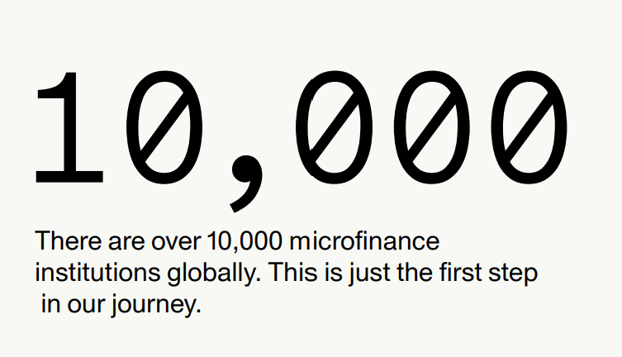
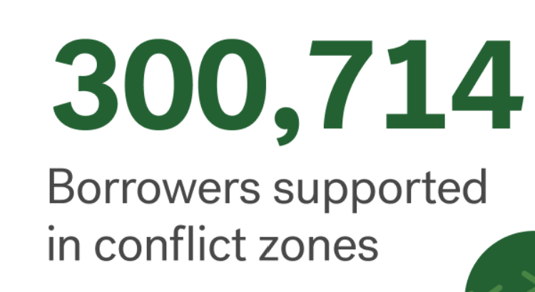
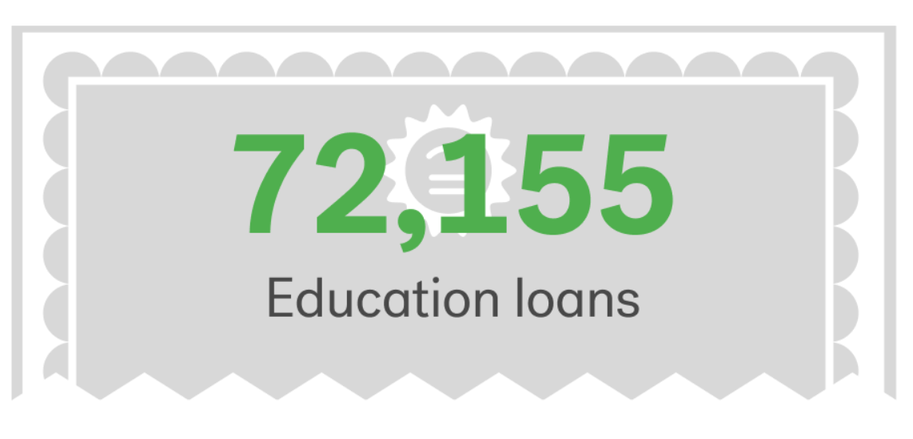
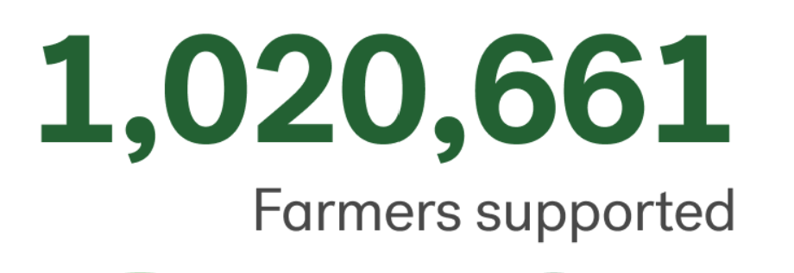
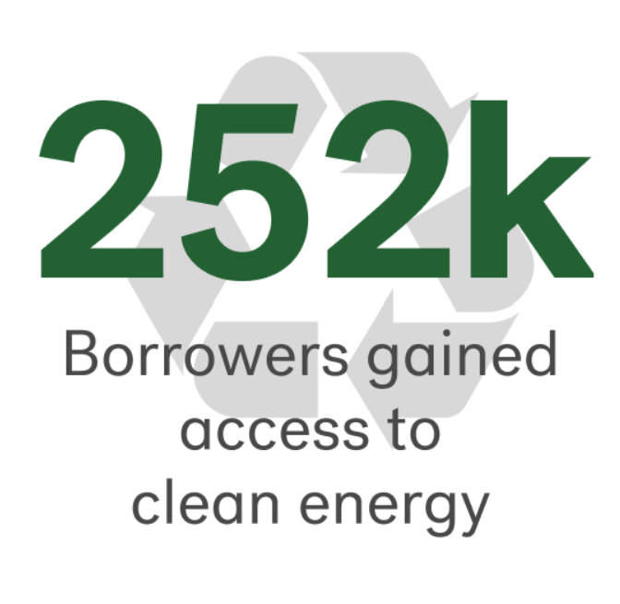
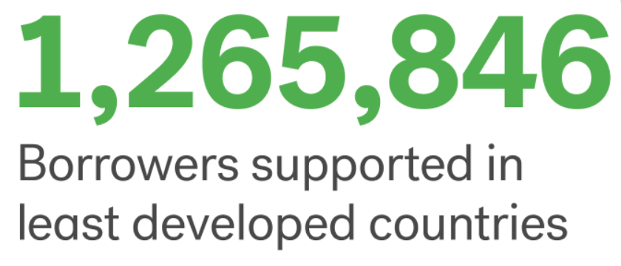
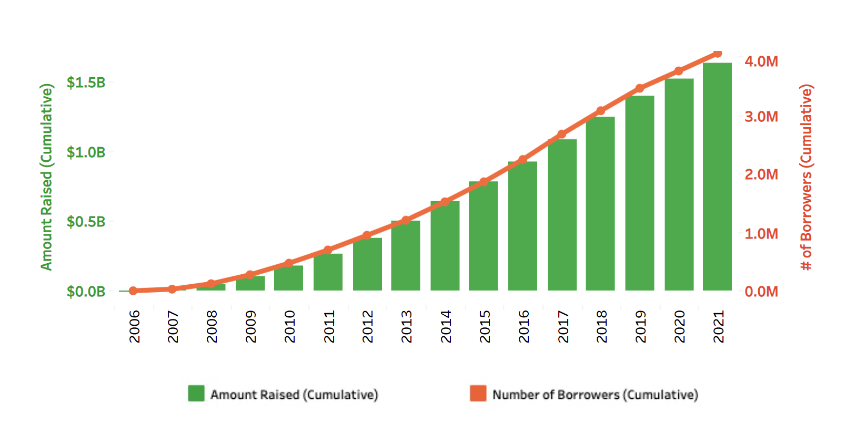
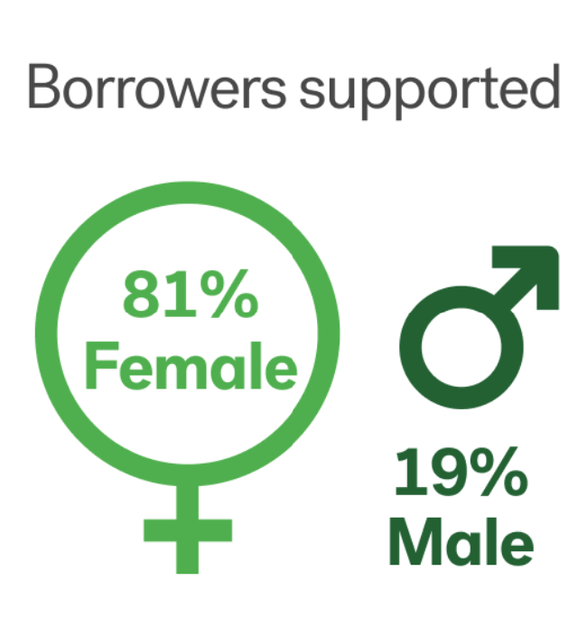
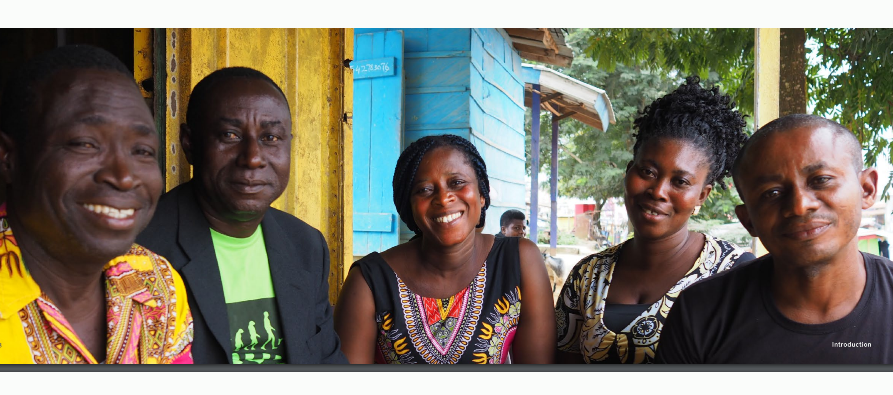
Why kiva?
Kiva, the first online person-to-person microfinance organization in 2005, with remarkable results. The site regularly “sold out” of loans. Every business listed on the site was funded within hours. New borrowers were added hourly and potential lenders were urged to check back often in order to participate. Kiva also capped loans at $25 so that more people had a chance to get involved. The loan cap itself received positive feedback.
Gabriela Villegas, a Kiva investor, commented, “Twenty-five dollars, that’s probably how much I spend on just one meal. But with that same money, I was able to change someone’s life.”
Over the course of Kiva’s fifteen years, from 2005 to the end of 2022, Kiva has funded $1.77 billion in loans to 4.4 million borrowers in 77 countries. Its remarkable to see how the business platform designed to achieve its vision & mission which dives us why we choose this data for our project review & analysis.
Interesting fact is 81 % of Kiva borrowers are women who are supposedly deprived of economic normalcy & still Kiva able to achieve astounding repayment rate of over 96%.
Notes:
Mission: is expanding financial access to help underserved communities thrive.
Vision: is a financially inclusive world where all people hold the power to improve their lives.
Repayment rates in the microfinance industry are much higher than for U.S. domestic loan lending. That’s because microfinance institutions are lending to people for whom getting a loan is their only shot at anything. If you’re given a $60 loan, your chance of getting another loan is contingent on you paying that back

Slide 3
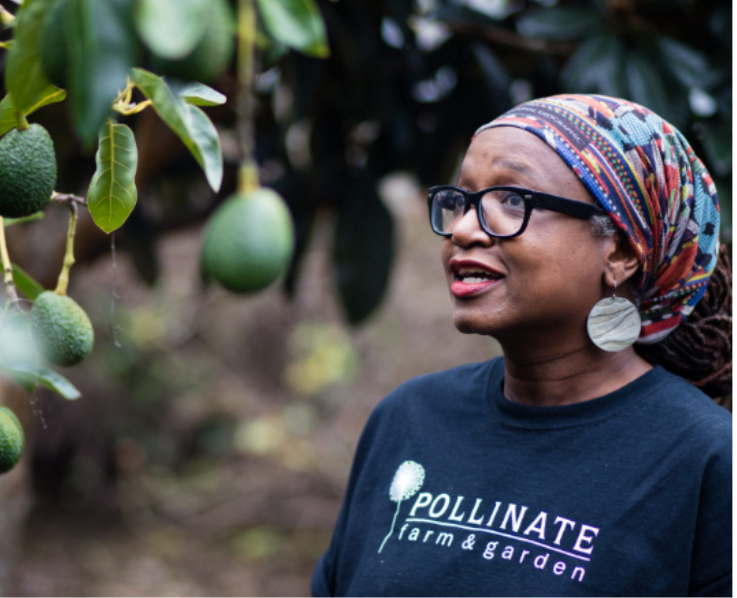
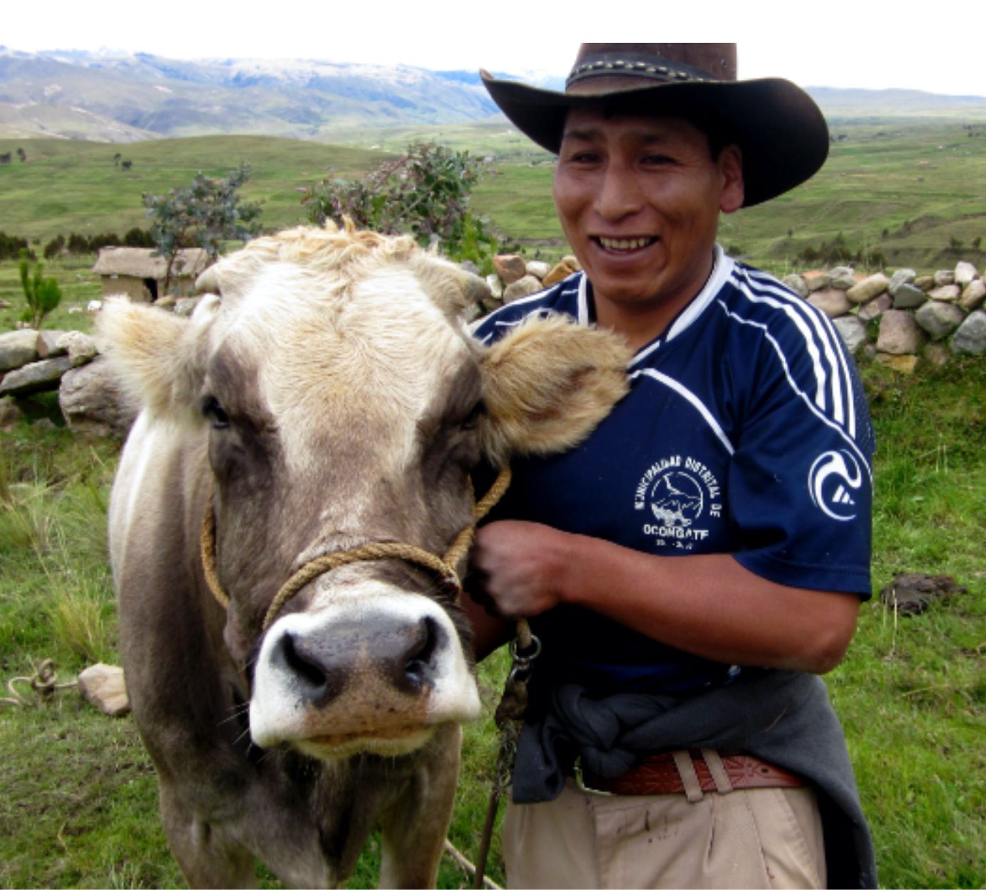
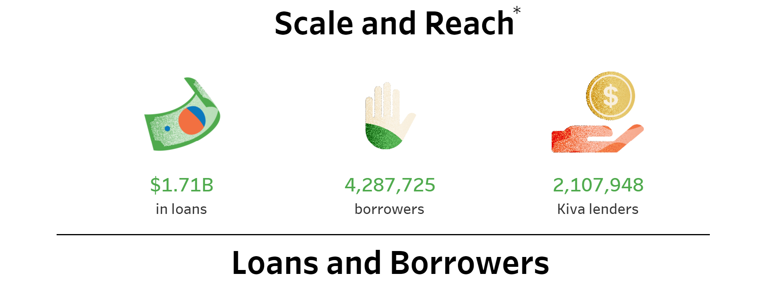
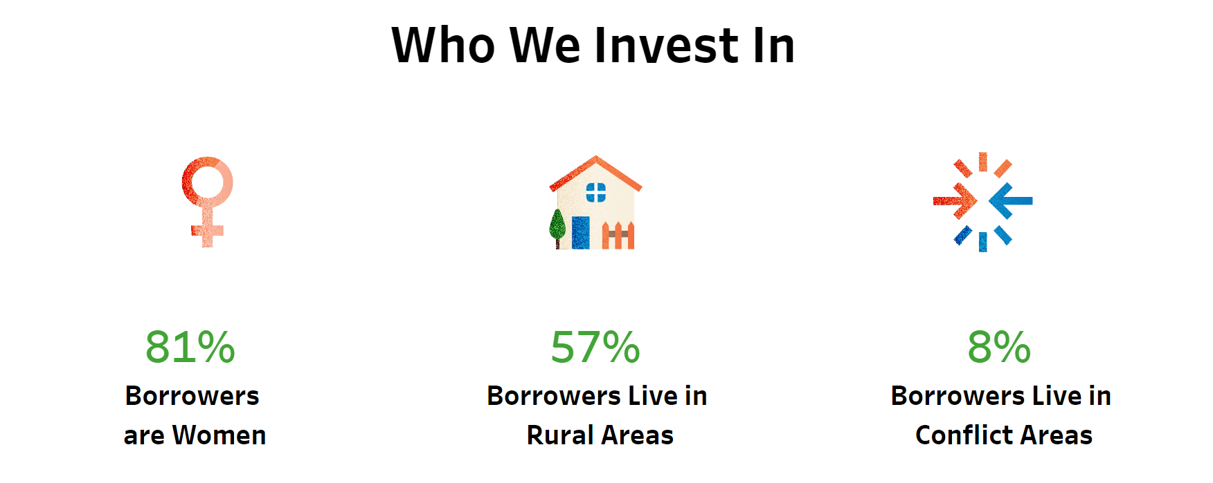
What is Kiva.org?
Kiva is an international non-profit, founded in 2005 and based in San Francisco, with a mission to connect people through lending to alleviate poverty..
Kiva is a peer-to-peer lending platform by which borrowers like Lourdes--who doesn’t have credit histories or access to bank loans--can get loans with no interest.
Lenders can loan money in increments of $25. Lenders browse borrower profiles on kiva.org and choose an entrepreneur they wish to fund. The lenders transfer their funds to Kiva through credit card processing
Lenders do not receive interest on the money they lend. Kiva includes personal stories of each person who applies for a loan so that lenders can connect with borrowers on a human level.
Kiva works with more than 300 microfinance institutions, social impact businesses, schools and non-profit organizations around the world, called "Field Partners", that post profiles of qualified local entrepreneurs on the Kiva website.

Slide 4

What is our aim
With the dataset downloaded from (https://www.kiva.org/build/data-snapshots), we propose to examine , identify and to
Which is the best fit machine learning model to predict loan funding based on model efficiency?
What are the meaningful insights from loan descriptions by using NLP models / text analytics?
What are the top features in loan descriptions that attracts funding?
We deployed most popular & standardized process for data mining – CRISP DM which is 6 step process starting with basic understanding of the business & the need of data mining project and ends with deployment of solution to meet the specific objective of business needs
Literature review & examine publicly available data on Kiva.
Adopt learnings from courses attended
DSCI 5240 - Data Mining and Machine Learning for Business
DSCI 5340 - Predictive Analytics and Business Forecasting
DSCI 5180 – Programming for Business Analytics
DSCI 5350 - Big Data Analytics
DSCI 5360 - Data Visualization for Analytics

Slide 5
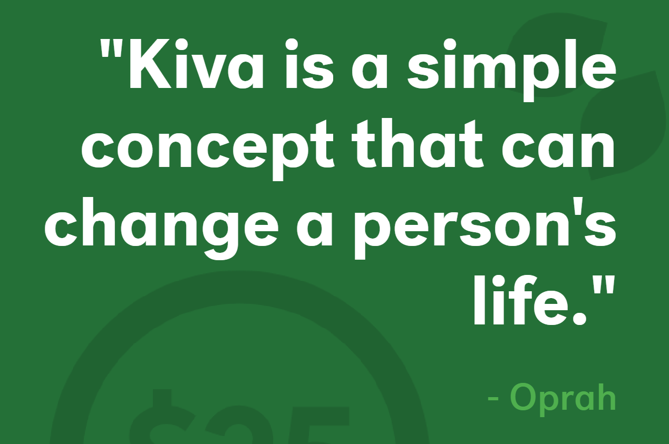
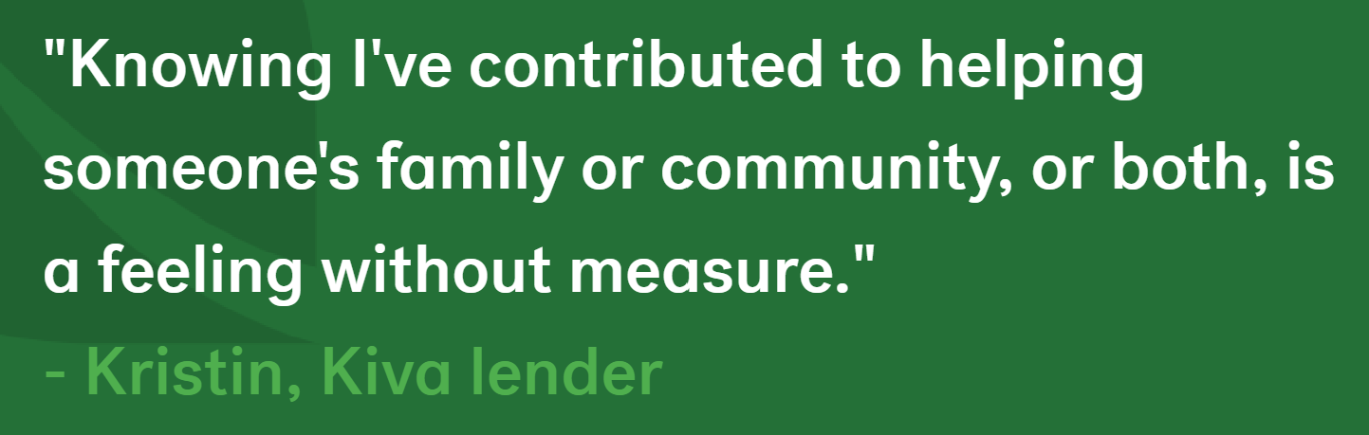
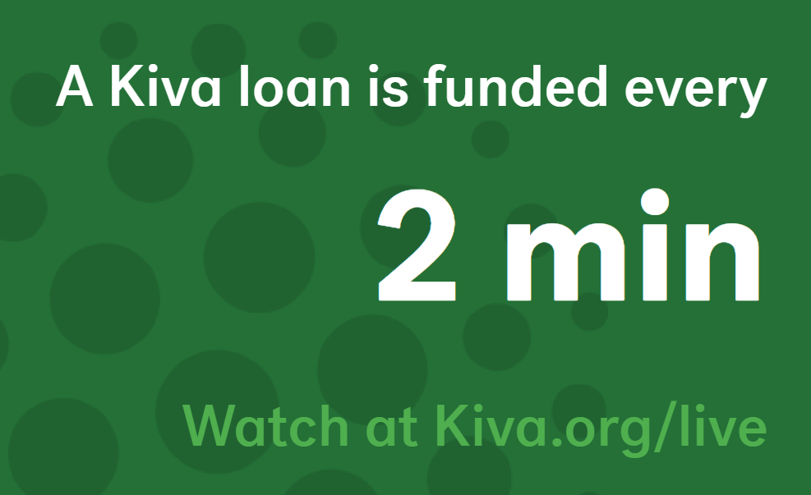
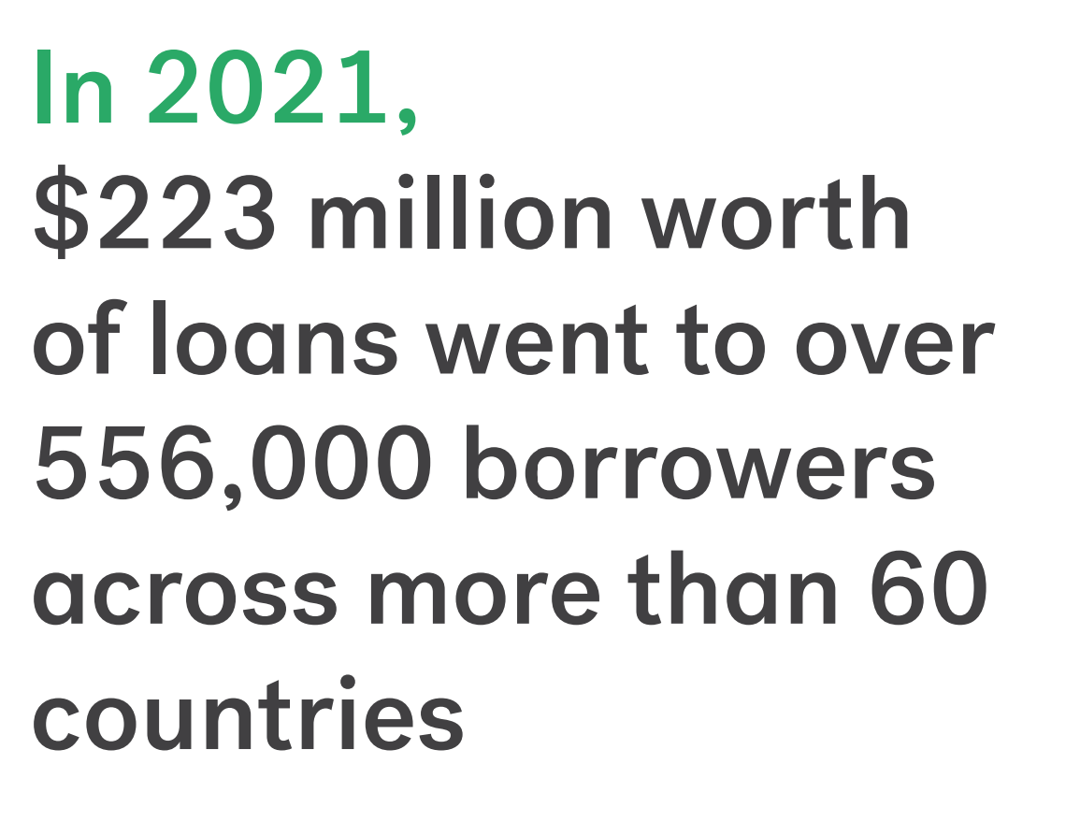
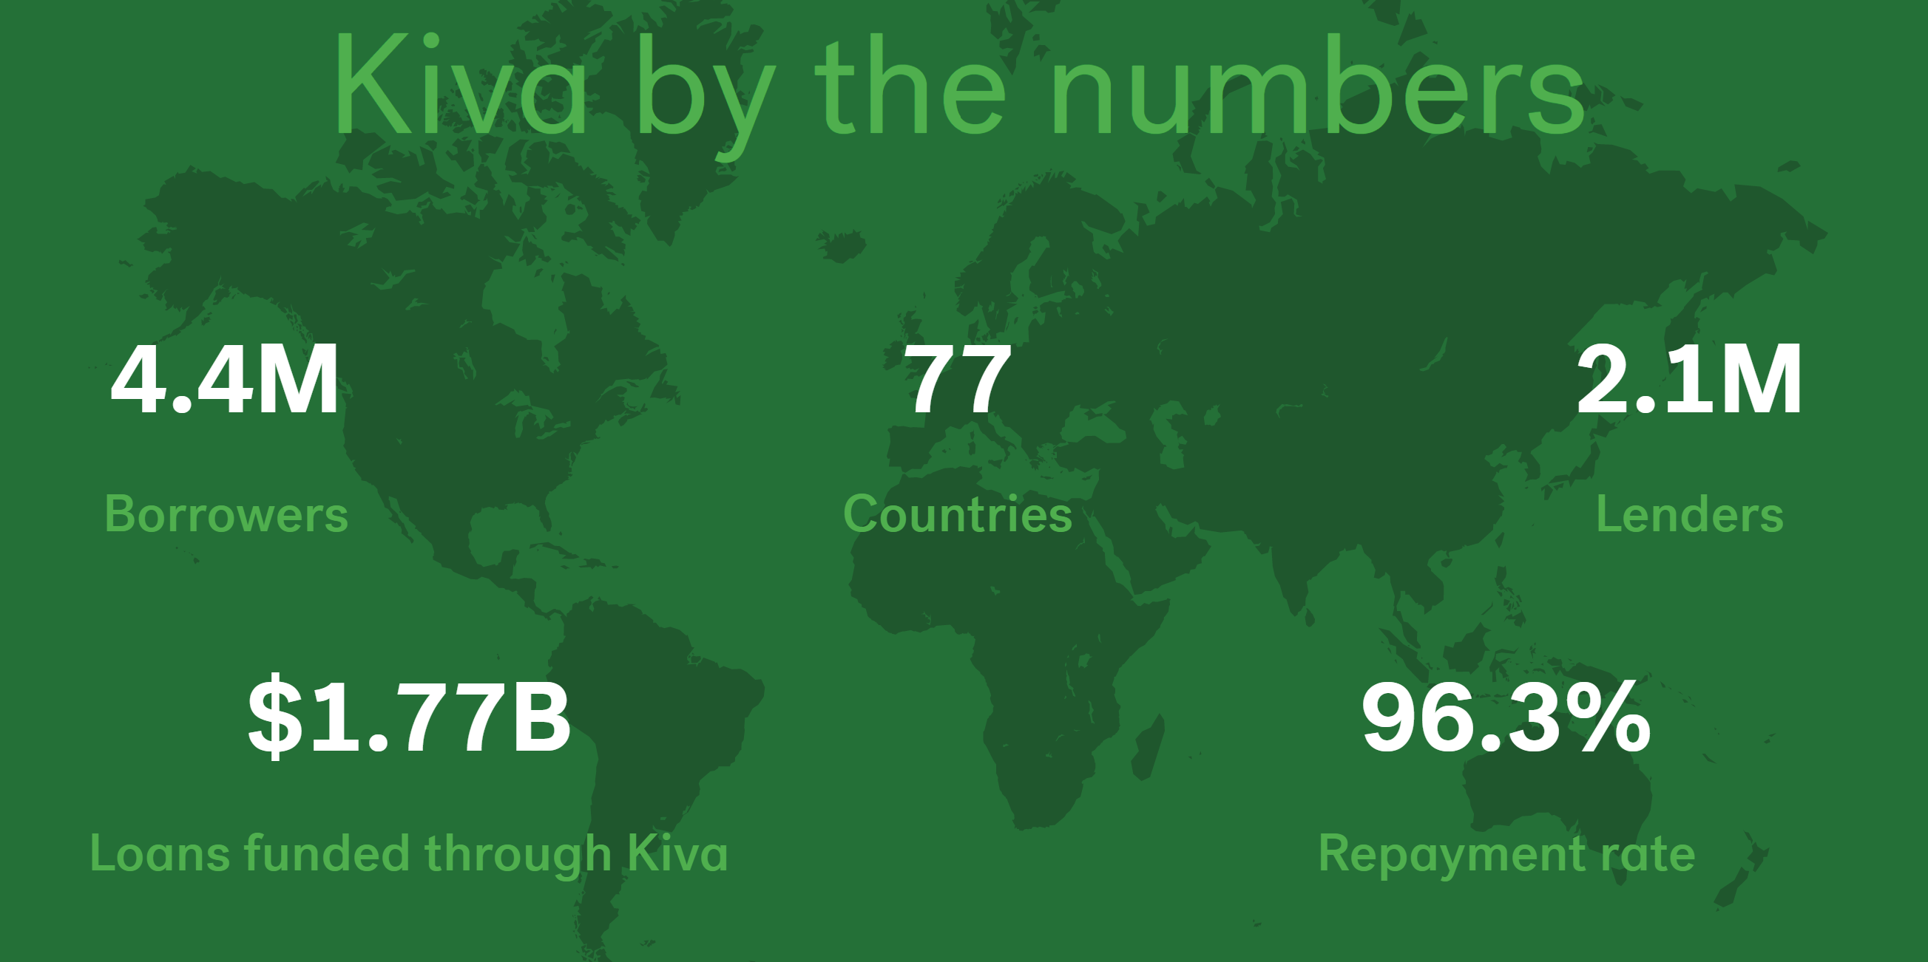

Research on KIVA : Kiva.org

Slide 6
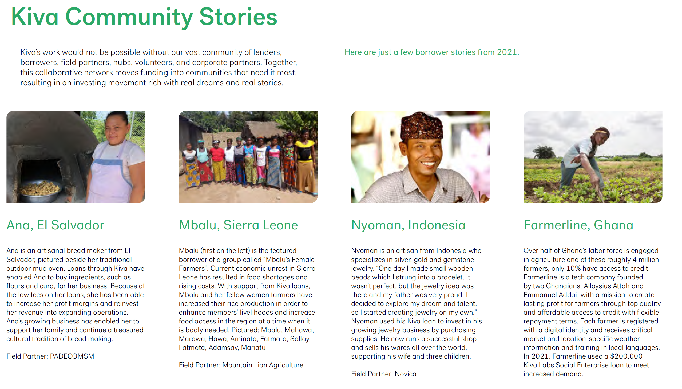
Research on KIVA : Testimonials

Slide 7
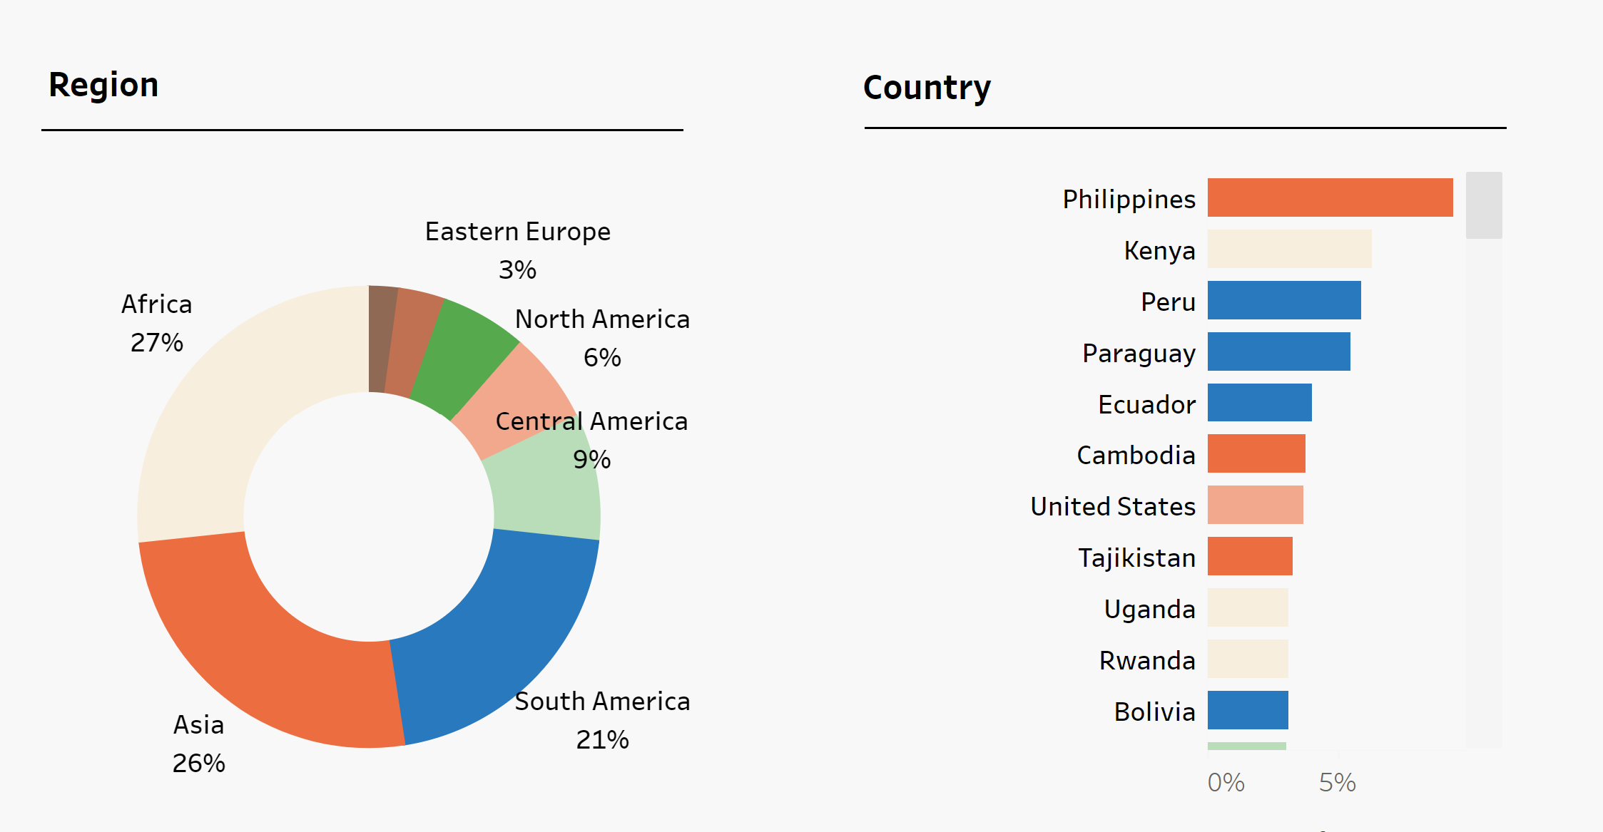
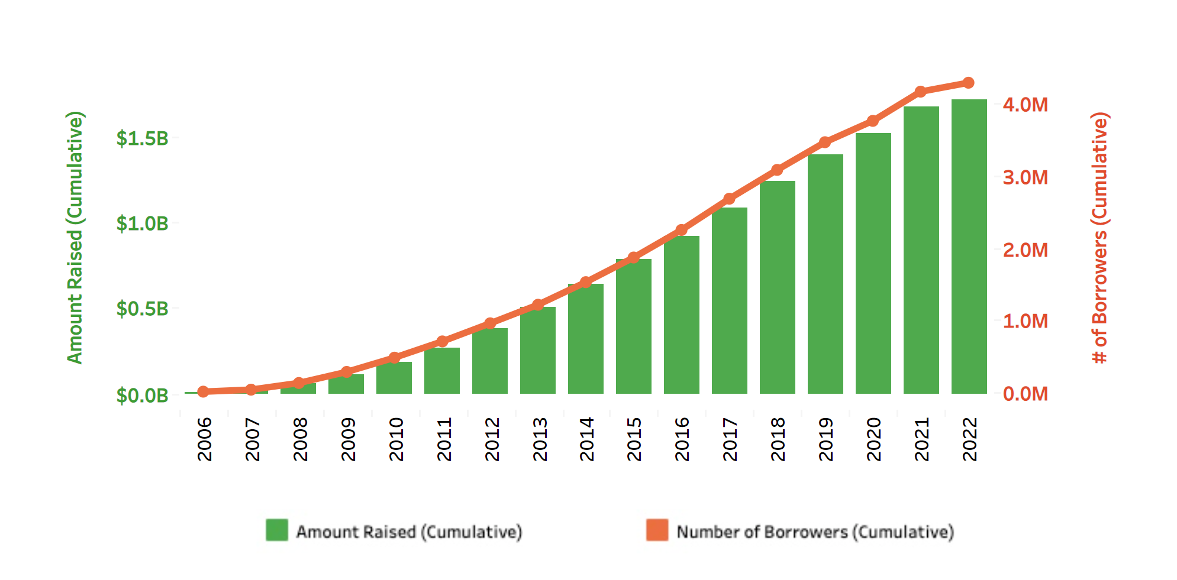
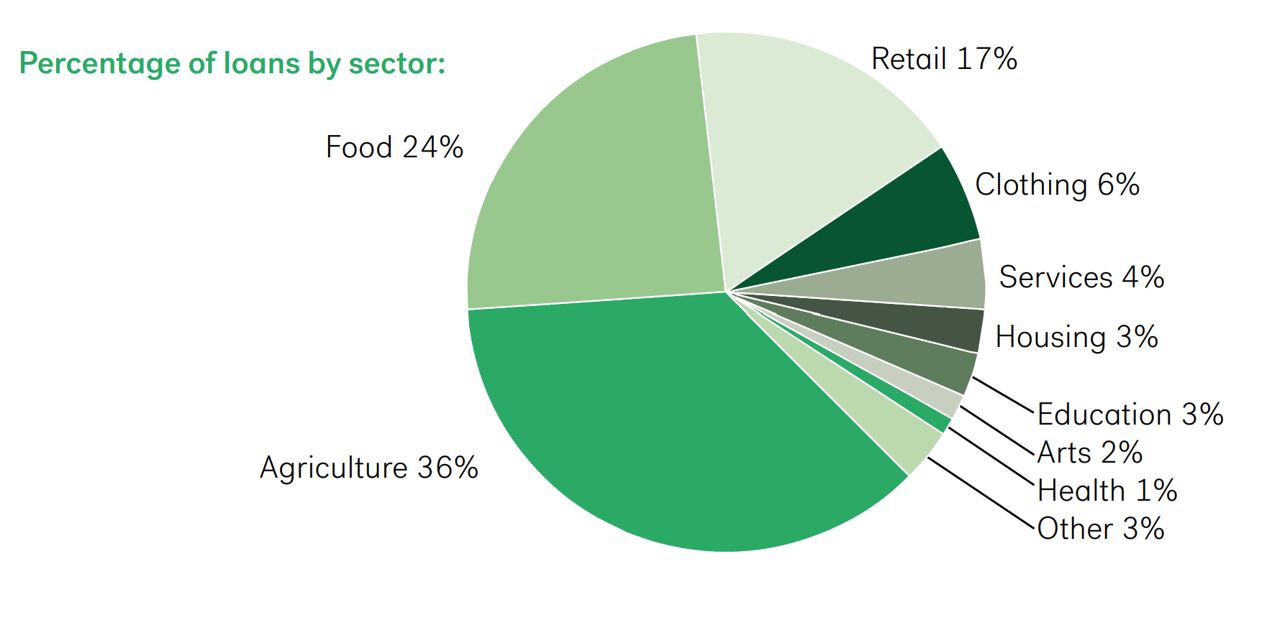

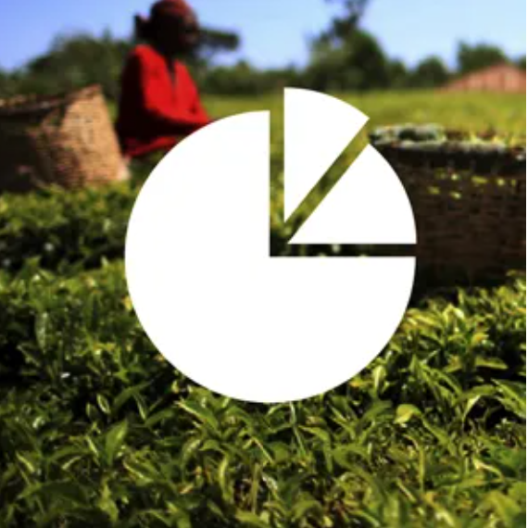


Kiva reach in 2022
Notes:
Over the course of Kiva’s fifteen years, from 2005 to the end of 2020, They have proudly funded $1.5 billion in loans to 3.8 million borrowers in 77 countries. Kiva lenders
and strategic partners funded over $127 million in loans to nearly 300,000 borrowers in 2020.
Women around the world have much less access to fair and affordable credit. In 2020, 82% of Kiva loans, or more than $100,000,000, went to over 240,000 women.
69% of Kiva’s borrowers lived in rural areas in 2020, totaling more than $71,200,000 raised for over 200,000 rural borrowers

Slide 8
How Kiva works
Application
A borrower applies for a loan
Loan amount may as small as $25
Repayment
Evaluation
Fund Raising
The loan is posted on Kiva portal seeking lenders to support
Loan application expires if not funded in 30days
Disburse loan
A loan can be disbursed directly or field partners
Loan amount may as small as $25
Loan amount may as small as $25
Borrowers repay the loan as per the term loan
Loan application goes through the underwriting & approval process
Fund raising complete
Reuse Repayments
Lenders use repayments to fund new loans, donate or withdraw the money

Slide 9

Research Questions
Which is the best fit machine learning model to predict loan funding based on model efficiency?
What are the meaningful insights from loan descriptions by using NLP models / text analytics?
What are the top features in loan descriptions that attracts funding?

Slide 10

Literature review - 1
Related work on Kiva data:
Microfinance is a promising, if imperfect, solution to alleviating poverty. It can be difficult to scale, and there is a risk of putting vulnerable populations on a kind of debt “treadmill.” However, historical success of microfinancing, coupled with modern innovation, allow for an optimistic outlook in this socially responsible lending space. Microfinance is not a novel idea, with its roots dating back to the 1800’s, when Lysander Spooner theorized an alleviation of poverty by dispensing microcredits to entrepreneurs and farmers (Garrity & Martin, 2018).
Take aways:
Several prior works have also shed light on Kiva’s online marketplace. Ly and Mason (2012) studied & described how loan parameters impacts the speed of the loans by building regression models on some of its quantitative characteristics
Results:
Results produced a model with an R2 of 0.42 and indicated that loan size describes most of the variance which tells us look deep into correlation of parameters impacting the target variable
References:
Annual Report Kiva.org 2021 https://www.kiva.global/wp-content/uploads/2022/06/AnnualReport_2021.pdf
Garrity, P., & Martin, C. (2018). Developing a microfinance model to break the cycle of poverty. Business Horizons, 61(6), 937–947. https://doi.org/10.1016/j.bushor.2018.07.002
Ly P. and Mason G. (2012). Competition Between Microfinance NGOs: Evidence from Kiva in World Development, 2012, 40(3):643-655 https://doi.org/10.1016/world.dev.2011.09.009
Gajjala, V., Gajjala, R., Birzescu, A., & Anarbaeva, S. (2011). Microfinance in online space: A visual analysis of Kiva.org. Development in Practice, 21(6), 880–893. https://doi.org/10.1080/09614524.2011.583637
Gajjala, V., Gajjala, R., Birzescu, A., & Anarbaeva, S. (2011). Microfinance in online space: A visual analysis of Kiva.org. Development in Practice, 21(6), 880–893. https://doi.org/10.1080/09614524.2011.583637

Slide 11

Literature review - 2
Machine learning applications on Crowdfunding platforms:
There are numerous studies on crowdfunding that target to predict different trends and project success (Ala’raj et al.2021). Some studies have discovered various semantic features, specific patterns, writing styles in loan applications to reveal the impact of language on the success or failure of a loan application on P2P platform. Crowdfunding success prediction is estimated over a text analytics method, where LDA is used to extract semantic features from the texts, along with feature selection, and data mining (Tripati 2021). In a similar work (Yuan.2016) crowdfunding data are analyzed by using LDA to classify into distinct topic classes.
Take aways:
Topic models such as the latent Dirichlet allocation (LDA) have become a well-known tool in machine learning (Blei et al., 2003). They have played an important role in a variety of data mining tasks, both within the scope of computer science (Blei et al., 2003; Liu et al., 2012;) and reaching out to other fields, such healthcare, political science & digital space.
Results:
To capture the semantic features of the text, topic models play a vital role. The semantic features are extracted as hidden topics. There have been numerous studies and applications of topic models since this idea was first introduced by Blei et al. in 2003.
References:
Ala’raj et al. J Big Data (2021) 8:69. Modelling customers credit card behaviour using bidirectional LSTM neural networks https://doi.org/10.1186/s40537-021-00461-7
Liu et al. (2012).” I Loan Because...”: Understanding Motivations for Pro-Social Lending. WSDM’12.
Blei, D.M.; Ng, A.Y.; Jordan, (2003). Latent dirichlet allocation. J. Mach. Learn. Res. 2003, 3, 993–1022.
Tripathi D, Edla DR, Bablani A, Shukla AK, Reddy BR. (2021) Experimental analysis of machine learning methods for credit score classifcation. Prog Artif Intell. 2021; 15:1–27.

Slide 12
Literature review - 3
Making Sense of social media using Machine Learning Models:
Among the several types of communication means, social media stands out as an important medium in facilitating interactions between social actors (Murthy D 2012). To understand the enormous numbers of posts shared on social media, NLP can understand human languages, as programmed for machines, to make predictions based on the observed social phenomena (Hannigan et al., 2019). On the other hand, machine learning models refers to computational methods using the train data to build and train a model for prediction and superior decision making.
Take aways:
Many industries have started adopting the NLP techniques to give their users better experience (Xing et al., 2018). Though it easy to get the other tabular data with help of many sources but it is tough to access and parse the data through unstructured, multi-lingual having different special characters.
Results:
So, creating information content from large sentences or stories is tedious and difficult.
References:
Murthy D. (2012). Towards a sociological understanding of social media: theorizing twitter. Sociology 46, 1059–1073 10.1177/0038038511422553 [CrossRef] [Google Scholar]
Hannigan T. R., Haans R. F. J., Vakili K., Tchalian H., Glaser V. L., Wang M. S., et al. (2019). Topic modeling in management research: rendering new theory from textual data. Acad. Manag. Ann. 13, 586–632. 10.5465/annals.2017.0099 [CrossRef] [Google Scholar]
Xing, F. Z., Cambria, E., & Welsch, R. E. (2018). Natural language based financial forecasting: A survey. Artificial Intelligence Review, 50(1), 49–73. https://doi.org/10.1007/s10462-017-9588-9.

Slide 13
Literature review - 4
Topic Modeling as a solution to deal with unstructured text data:
We are witnessing its multifold impact in social media with the use of latest communication applications such as Facebook. Twitter, LinkedIn etc. For instance, scholars have indicated that shorter posts usually lead to a higher engagement rate on Facebook (Sabate et al., 2014), possibly for the reason that short messages lower the amount of intellectual energy needed for information processing (She et al., 2022).
Take aways:
The short and unstructured posts fit with social media way, they enhance the difficulty for algorithms to make point of digital communication. Common tasks arise from using composite words, acronyms, and vague sentences (Ariffin and Tiun, 2020).
Results:
LDA have a tendency to neglect co-occurrence relationships. Similarly, other researchers underline that inaccurate and sparse datasets are inappropriate for LDA (Chen et al., 2019) due to a lack of features for statistical learning (Cai et al., 2018)
References:
Ariffin S. N. A. N., Tiun S. (2020). Rule-based text normalization for Malay Social Media Texts. Int. J. Adv. Comput. Sci. Appl. 11:21. 10.14569/IJACSA.2020.0111021 [CrossRef] [Google Scholar]
Sabate F., Berbegal-Mirabent J., Cañabate A., Lebherz P. R. (2014). Factors influencing popularity of branded content in Facebook fan pages. Eur. Manag. J. 32, 1001–1011. 10.1016/j.emj.2014.05.001 [CrossRef] [Google Scholar]
She J., Zhang T., Chen Q., Zhang J., Fan W., Wang H., et al. (2022). Which social media posts generate the most buzz? Evidence from WeChat. Internet Res. 32, 273–291. 10.1108/INTR-12-2019-0534 [CrossRef] [Google Scholar]
Chen Y., Zhang H., Liu R., Ye Z., Lin J. (2019). Experimental explorations on short text topic mining between LDA and NMF based Schemes. Knowl. Based Syst. 163, 1–13. 10.1016/j.knosys.2018.08.011 [CrossRef] [Google Scholar]
Cai G., Sun F., Sha Y. (2018). Interactive Visualization for Topic Model Curation. Tokyo: IUI Workshops.

Slide 14
Data Description
Variable Name | Description
LOAN_ID | Unique ID for loan
LOAN_NAME | name of the loan
ORIGINAL_LANGUAGE | Language of loan description with levels English (en), Spanish (es), French (fr), Indonesian (id), Russian (ru)
DESCRIPTION_TRANSLATED | Loan description translated to English
FUNDED_AMOUNT | Loan amount funded
LOAN_AMOUNT | Loan Amount requested
STATUS | Loan Status
IMAGE_ID | Image-ID of the borrower picture
IMAGE-BI | Image-ID Binary level
ACTIVITY_NAME | Activity for which loan is requested
SECTOR_NAME | Sector in which loan is sought
ACTIVITY_NAME_INT | Activity name categorized into numbers
SECTOR_NAME-INT | Sector Name categorized into numbers
LOAN_USE | Description about use of loan
COUNTRY_CODE | Country Code
COUNTRY_NAME | Country Name
COUNTRY_CODE_INT | Country code categorized into Numbers
TOWN_NAME | Town Name
CURRENCY_POLICY | currency policy whether forex fluctuation risk is shared or standard
CURRENCY_EXCHANGE_COVERAGE_RATE | % of Forex fluctuation risk shared between field partner & lenders
PARTNER_ID | Field partner ID
POSTED_TIME | Loan posted time in Kiva portal for fund raising
PLANNED_EXPIRATION_TIME | expiration time of the loan
DISBURSE_TIME | Disbursed time of the loan
RAISED_TIME | Loan application raised time
LENDER_TERM | Lender terms
NUM_LENDERS_TOTAL | Total number of lenders for a given loan
NUM_JOURNAL_ENTRIES | Number of journal entries for a loan
NUM_BULK_ENTRIES | No of bulk entries for a loan
BORROWER_GENDERS | Gender of the borrower
REPAYMENT_INTERVAL | Repayment schedule
DISTRIBUTION_MODEL | Loan distribution model whether it is Direct or through field partner
BORROWER_NAMES | names of borrowers
VIdeoID | If a video was posted, its ID.
We will (https://www.kiva.org/build/data-snapshots) for Data analysis & understanding.
Loan sample data set consists of 34 variables including
Loan
Loan barrower name/gender
Place: city/zip/country
Currency & amount : funded & loan amount
Status
Loan term, lender details
Repayment interval, picture, video ID
Distribution model, partner ID etc.
Lender sample: has 14 variables including details of lenders , name, date of membership, city & address
Loan_lenders sample has 2 variables, LoanID & name of the lenders

Slide 15
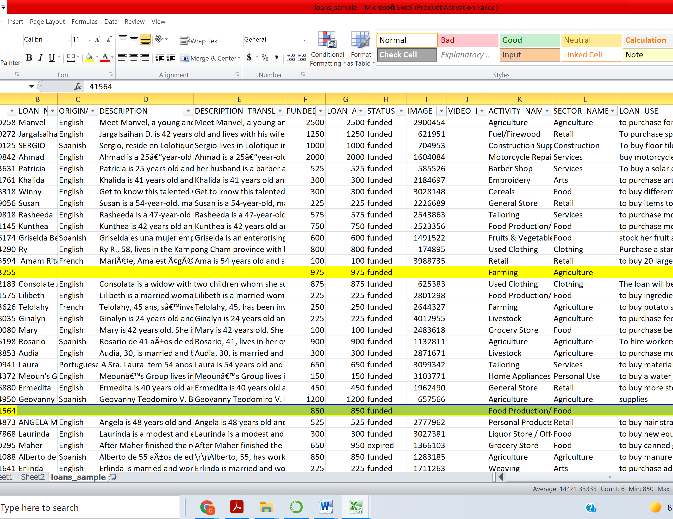
Sample Data
Loan Data Set

Slide 16
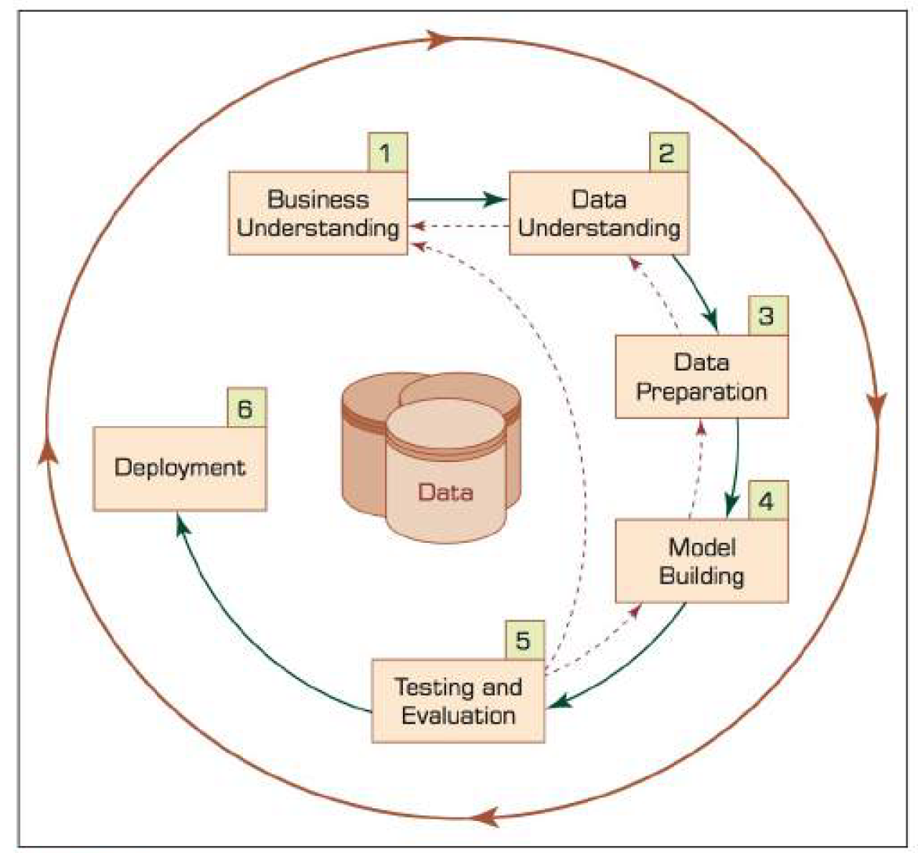
Research Methods
To conduct Machine Learning projects efficiently, it is important to define the tasks to be completed and the roles involved. This defines a structured process that drives the project team towards a well-defined goal and ensures a collective understanding of the business needs
We adapted the well-known and widely accepted Cross-Industry Standard Process for Data Mining (CRISP-DM) (F. Martínez-Plumed et al., 2021) to reflect Machine Learning specifics and ensure a successful execution of Machine Learning projects
CRISP DM methodology has six steps, starting with basic understanding of the business & the need of data mining project and ends with deployment of solution to meet the specific objective of business need. The key to success of any CRISP DM project is to ensure initial steps are strong & correct as lateral steps provides the outcome on data & assumptions considered in earlier steps
Model Building:
In this step, we shall use several types of predictive models on the transformed data to conduct experiments to determine best suited model based on model efficiency, & confusion matrix results. We explored 5 Data Mining & Machine Learning Models on our data set as shown in below figure.
Regression
Decision Tree
Random Forest
Naïve bayes
Neural Network
We used topic modeling approach to determine key features from loan description data.

Slide 17
Model Building & Research methods
Data
Target
Data
Clean
Data
Patterns
Insight
Action
Sampling
Preprocessing
Modeling
Interpretation
Decision-Making

Slide 18
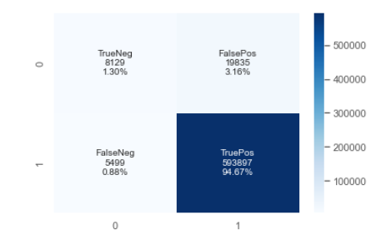
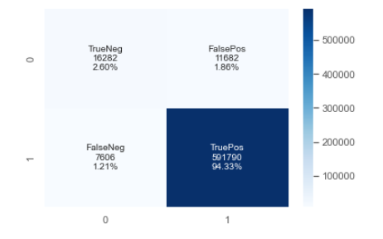
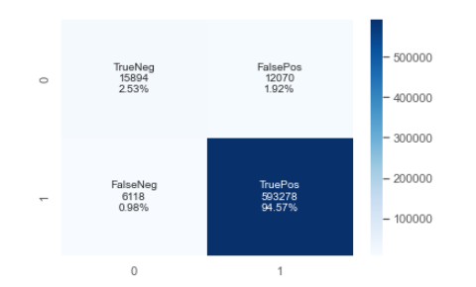
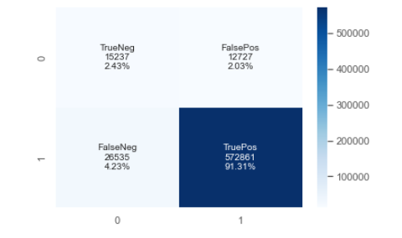
Results analysis and Discussion
Logistic Regression
Decision Tree
Neural network has the highest efficiency
Naïve Bayes
Random Forest

Slide 19
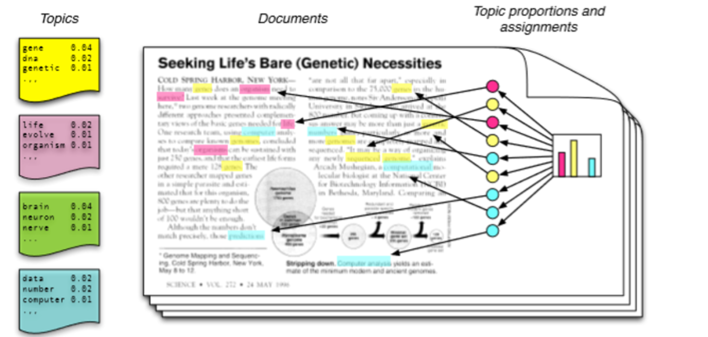
Research Methods
Latent Dirichlet Allocation is a probabilistic method for Topic Modelling.
We have to choose the number of topics k that we want to ‘discover’ in our corpus.
The results then find these hidden topics, and give us the words that make up each topic, in the form of a probability distribution over the vocabulary for each topic.
They also give us the topical mix for each document, in the form of a probability distribution over the topics for each document.
Model effectiveness is evaluated through Coherence value which ranges from 0 to 1 & closest to 1 would be considered as good fit.
Source: https://rpubs.com/chelseyhill/672546

Slide 20
Topic Modelling Output : Key features & its weights
Result of topic modeling with key features & its weights
[(Topic_1,
'0.028*"loan" + 0.019*"group" + 0.017*"farm" + 0.016*"child" + 0.016*"year" ' '+ 0.016*"farmer" + 0.013*"family" + 0.012*"farming" + 0.011*"profit" + ' '0.009*"income"'),
(Topic_2,
'0.055*"business" + 0.037*"loan" + 0.036*"year" + 0.033*"child" + ' '0.028*"php" + 0.024*"nwtf" + 0.022*"request" + 0.020*"philippine" + ' '0.019*"sell" + 0.018*"future"'),
(Topic_3,
'0.055*"business" + 0.033*"loan" + 0.030*"year" + 0.025*"child" + ' '0.024*"sell" + 0.016*"buy" + 0.015*"old" + 0.013*"family" + 0.013*"school" + 0.012*"marry"'),
(Topic_4,
'0.024*"loan" + 0.022*"work" + 0.019*"year" + 0.017*"business" + 0.012*"buy" ' '+ 0.012*"sell" + 0.012*"family" + 0.011*"child" + 0.011*"old" + ' '0.010*"make"'),
(Topic_5,
'0.026*"loan" + 0.023*"family" + 0.018*"income" + 0.017*"year" + ' '0.013*"child" + 0.012*"old" + 0.011*"live" + 0.011*"work" + 0.011*"dear" + ' '0.010*"husband"')]

Slide 21
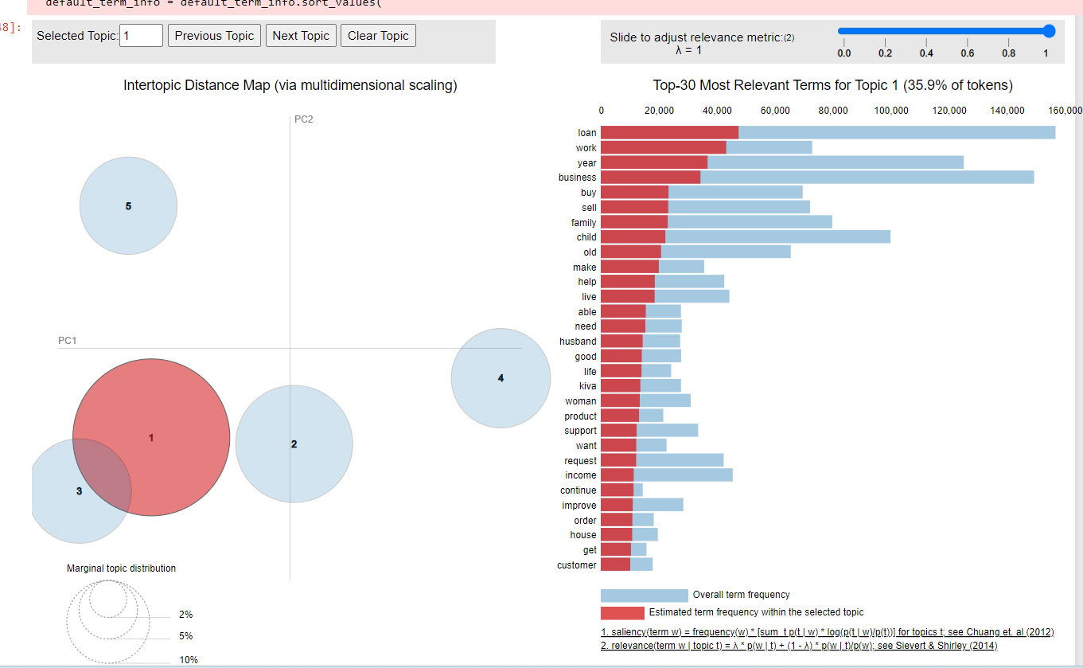
Results analysis and Discussion
56 % of most relevant terms falls in topic 1 & topic 2
13.8% of unique terms falls in topic 5

Slide 22
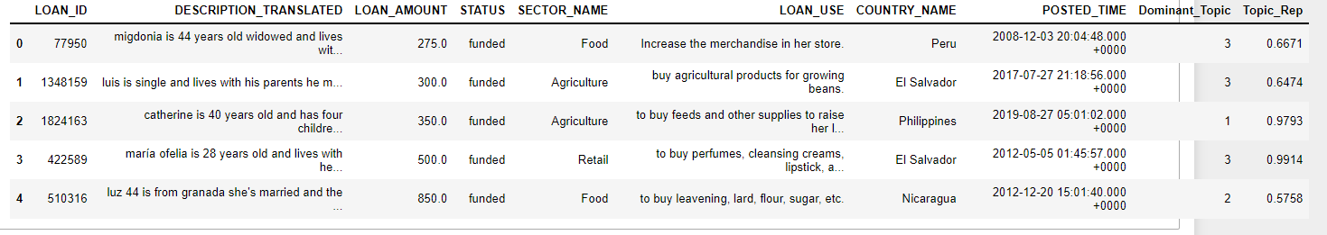
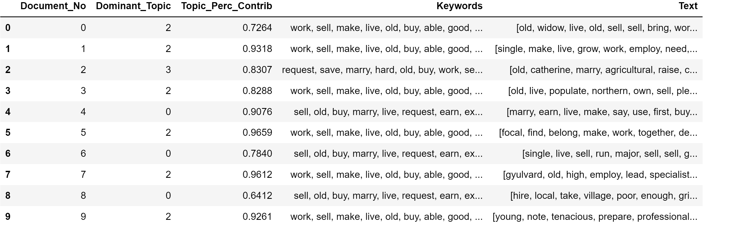
Summary of finding :Topic Modelling
Dominant topic of top 3 segments are
Agriculture
Retail
Food

Slide 23
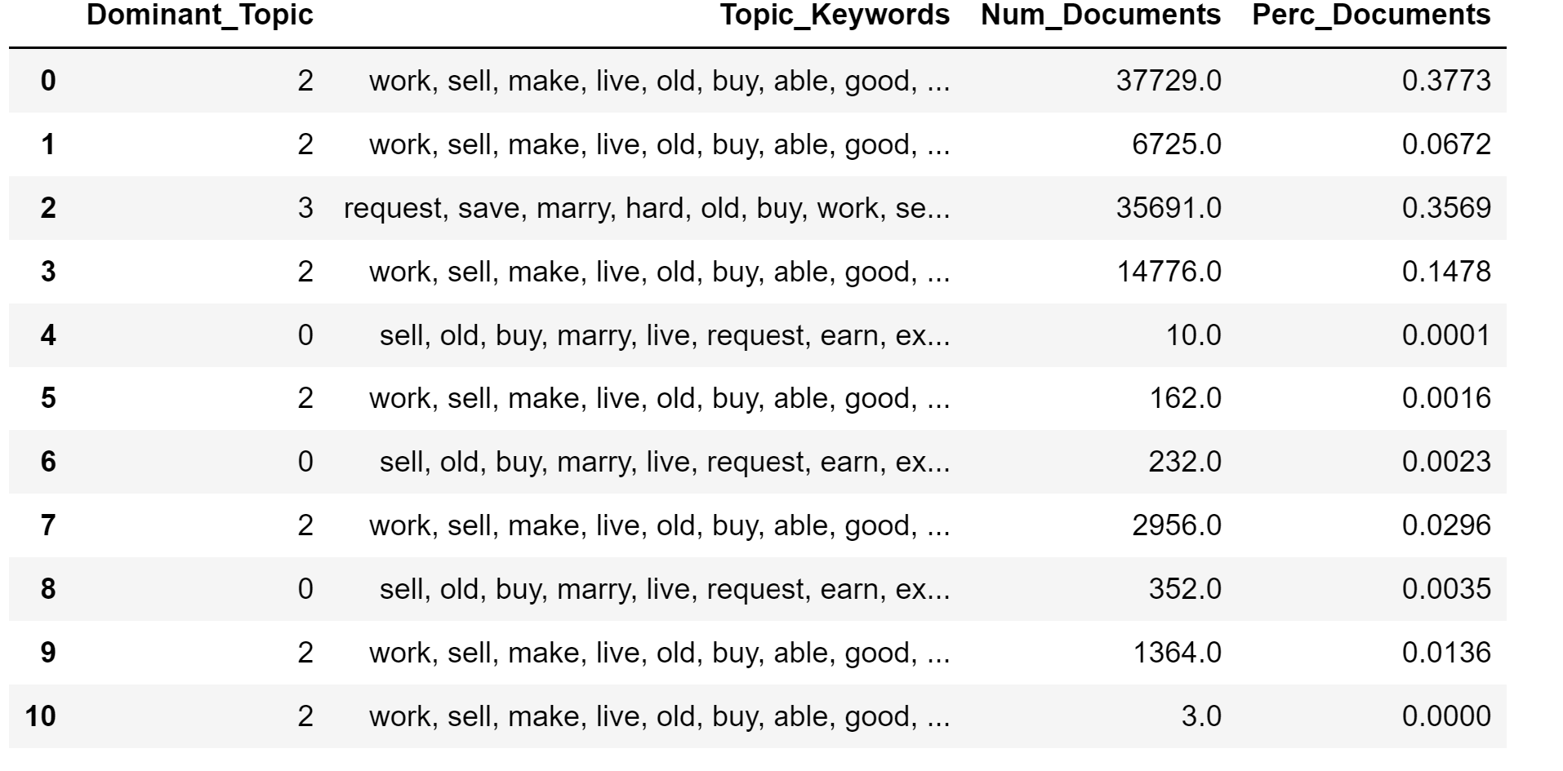
Summary of finding :Topic Modelling
Key words & no of documents clustered mainly into topic dominant topic 2 upto 73%

Slide 24
Contribution to the literature and practice
Future work :
Identify key features of loan applications which are being rejected due to lack of information in the loan application
Perform impact of NLP Topic model on Lenders bias over gender, sector or geography.

Slide 25
Research limitations
Fixed K (the number of topics is fixed and must be known ahead of time)
Uncorrelated topics (Dirichlet topic distribution cannot capture correlations)
Non-hierarchical (in data-limited regimes hierarchical models allow sharing of data)
Static (no evolution of topics over time)
Bag of words (assumes words are exchangeable, sentence structure is not modeled)
Unsupervised (sometimes weak supervision is desirable, e.g. in sentiment analysis)

Slide 26
Closing Remarks
Kiva may use NLP – Topic modelling model to suggest lenders pick their customized loan applications based on their interest sector & geography
We also recommend Kiva to consider loan prediction model based on the Neural network & Text analytics to fund the loan applications.

Slide 27
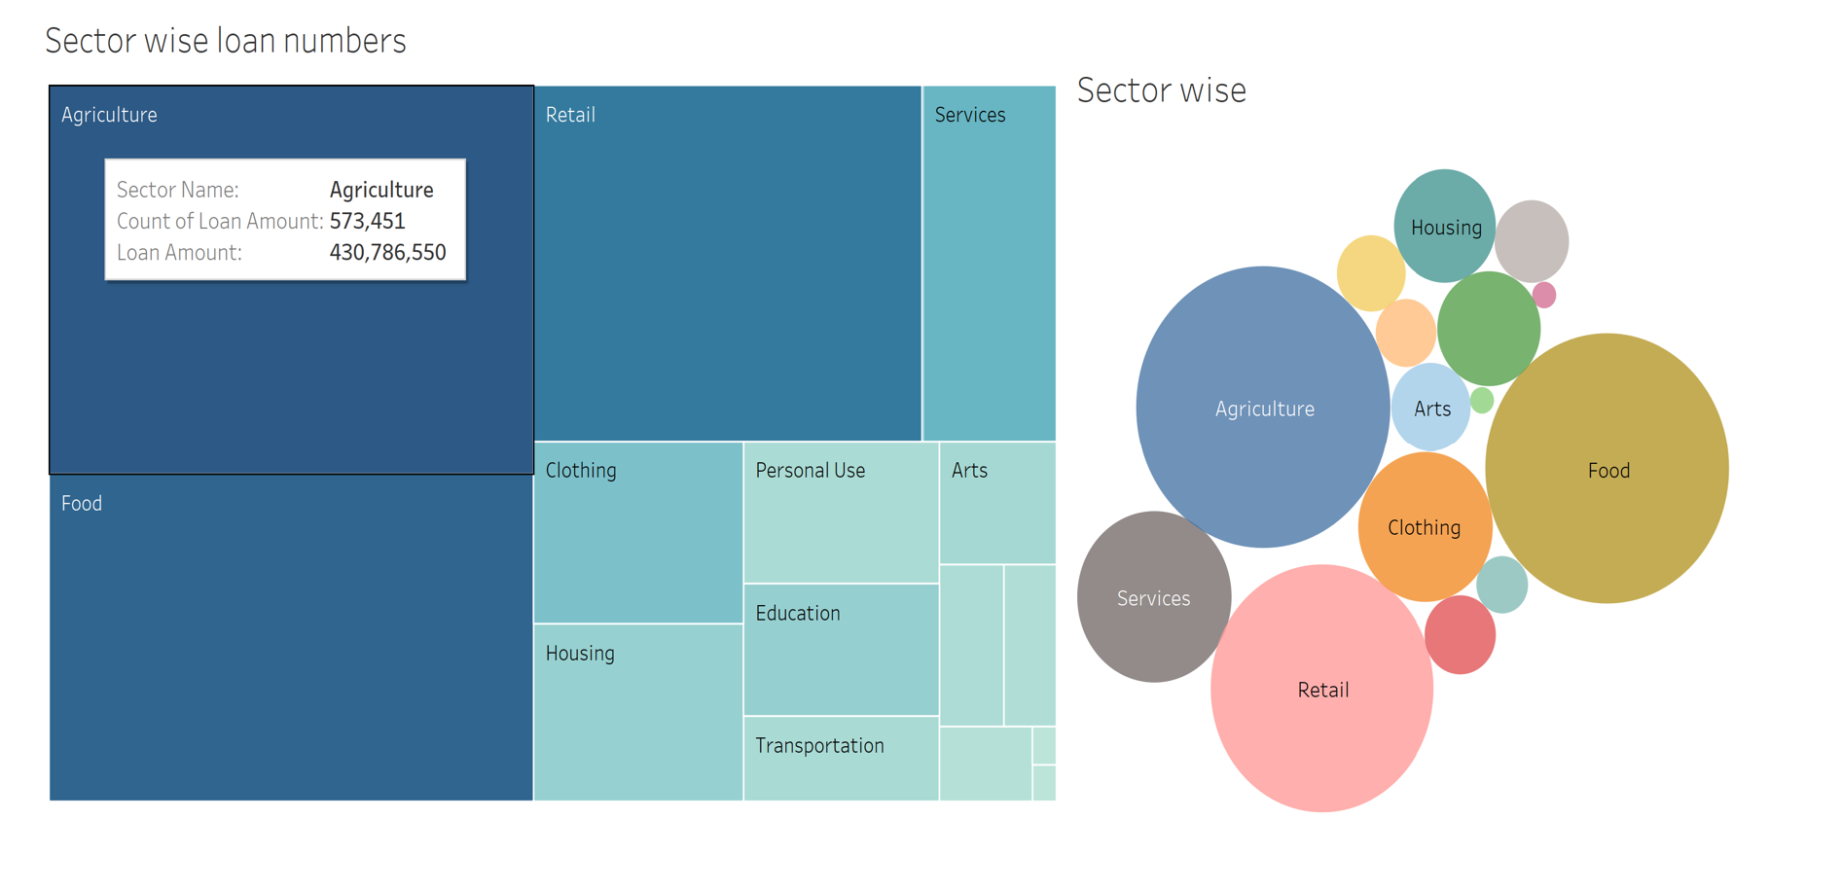
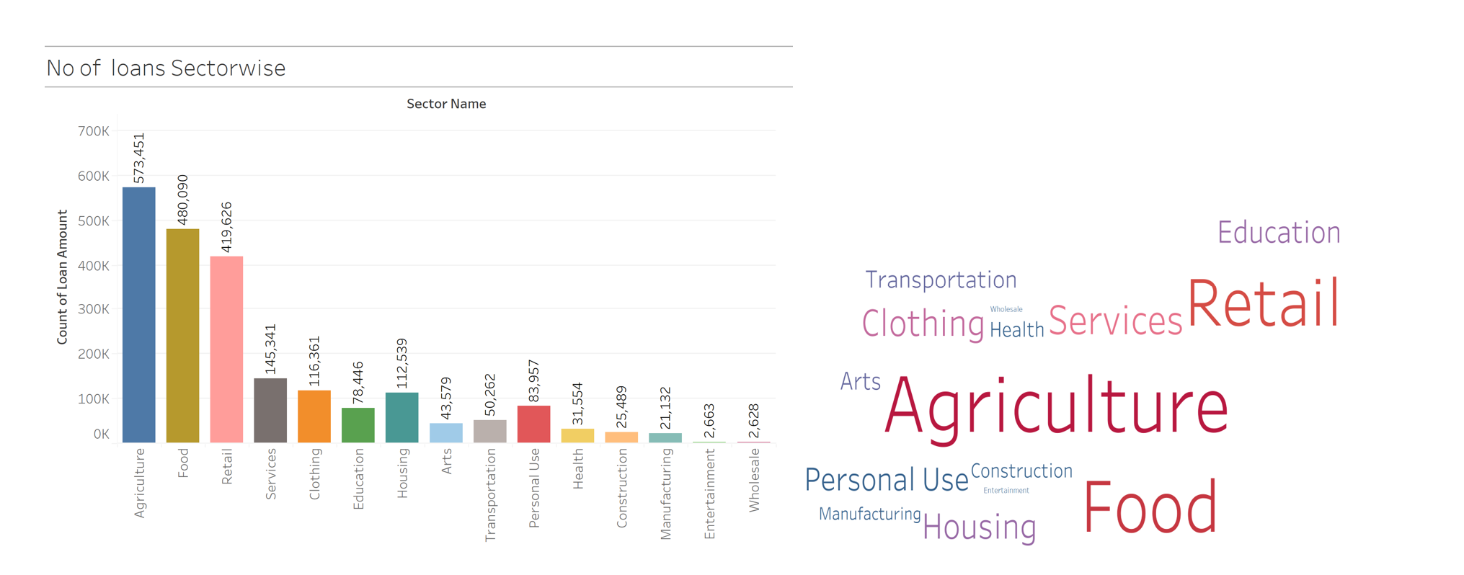
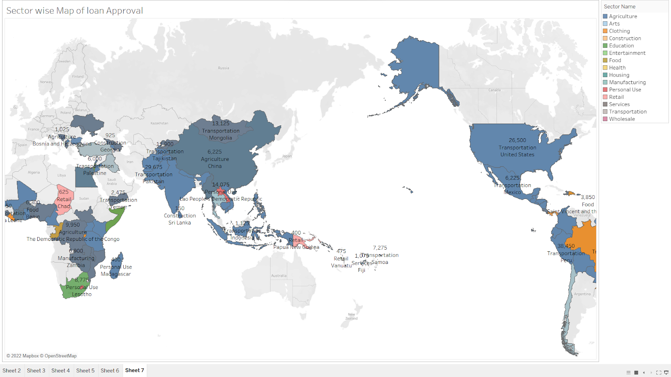
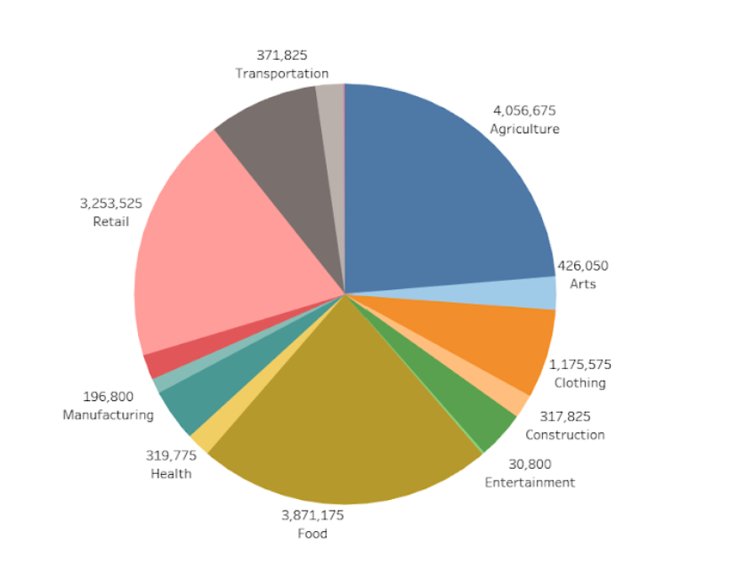
Descriptive Analysis - tableau

Slide 28
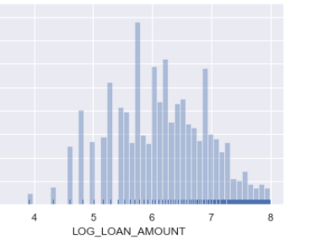
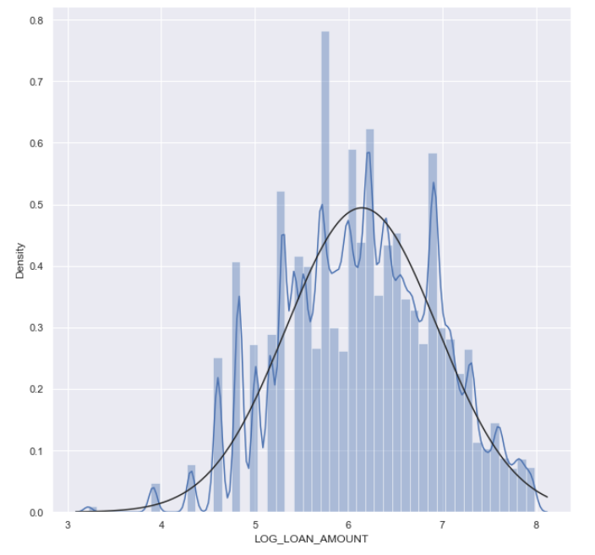
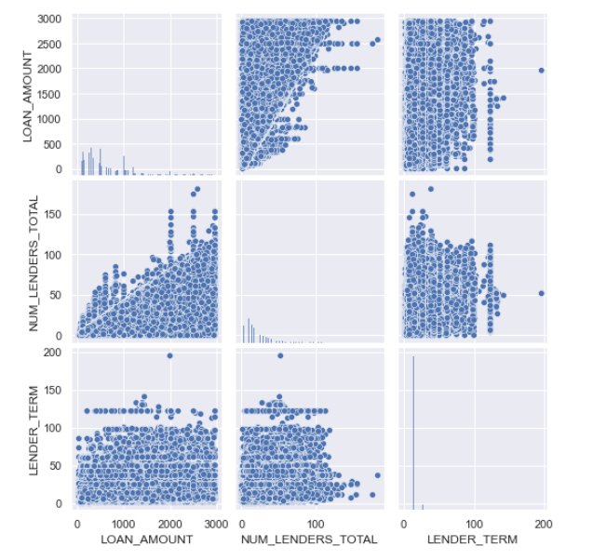
Data Exploration

Slide 29
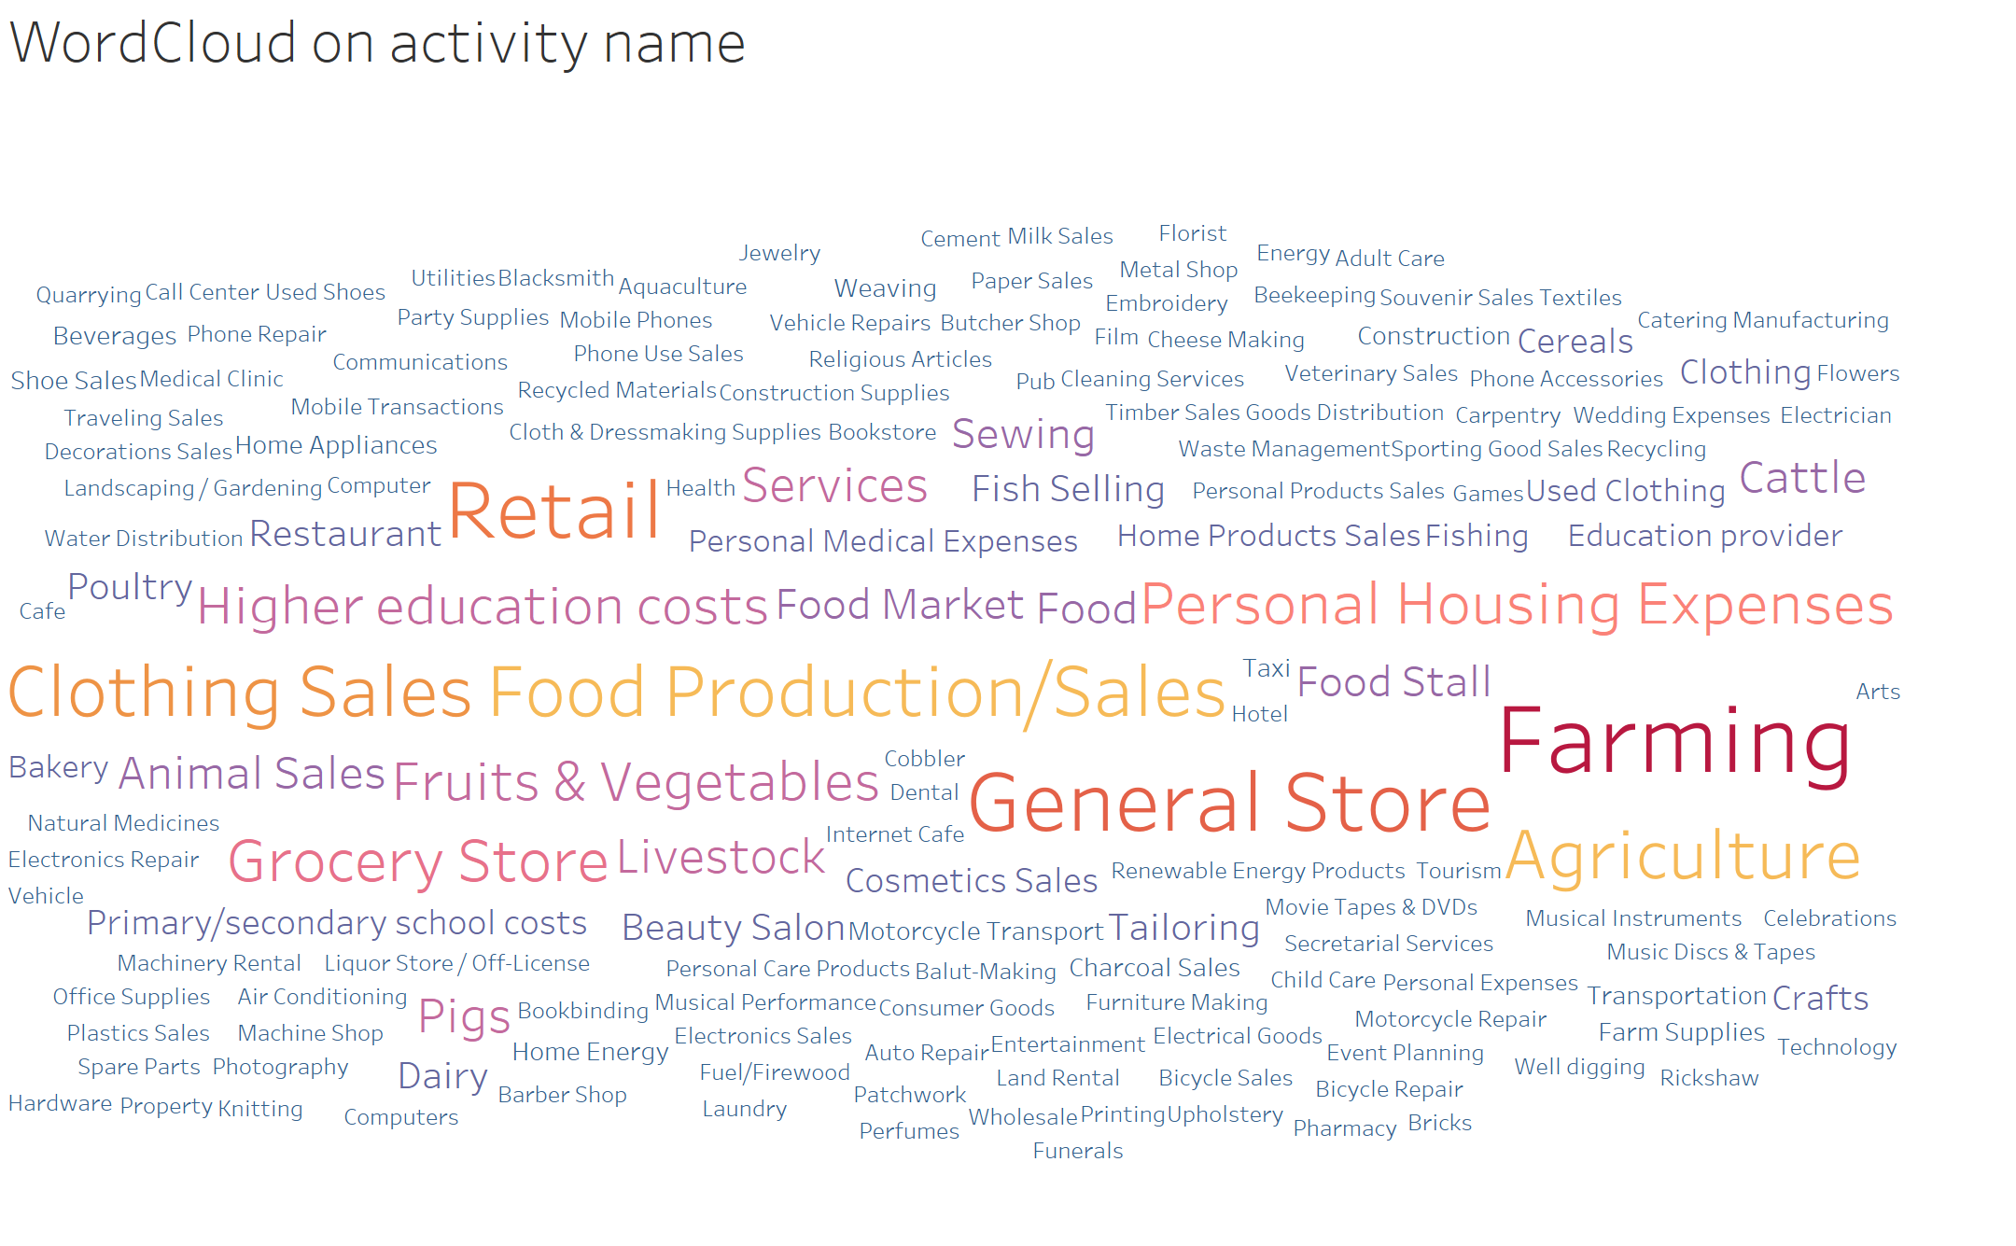
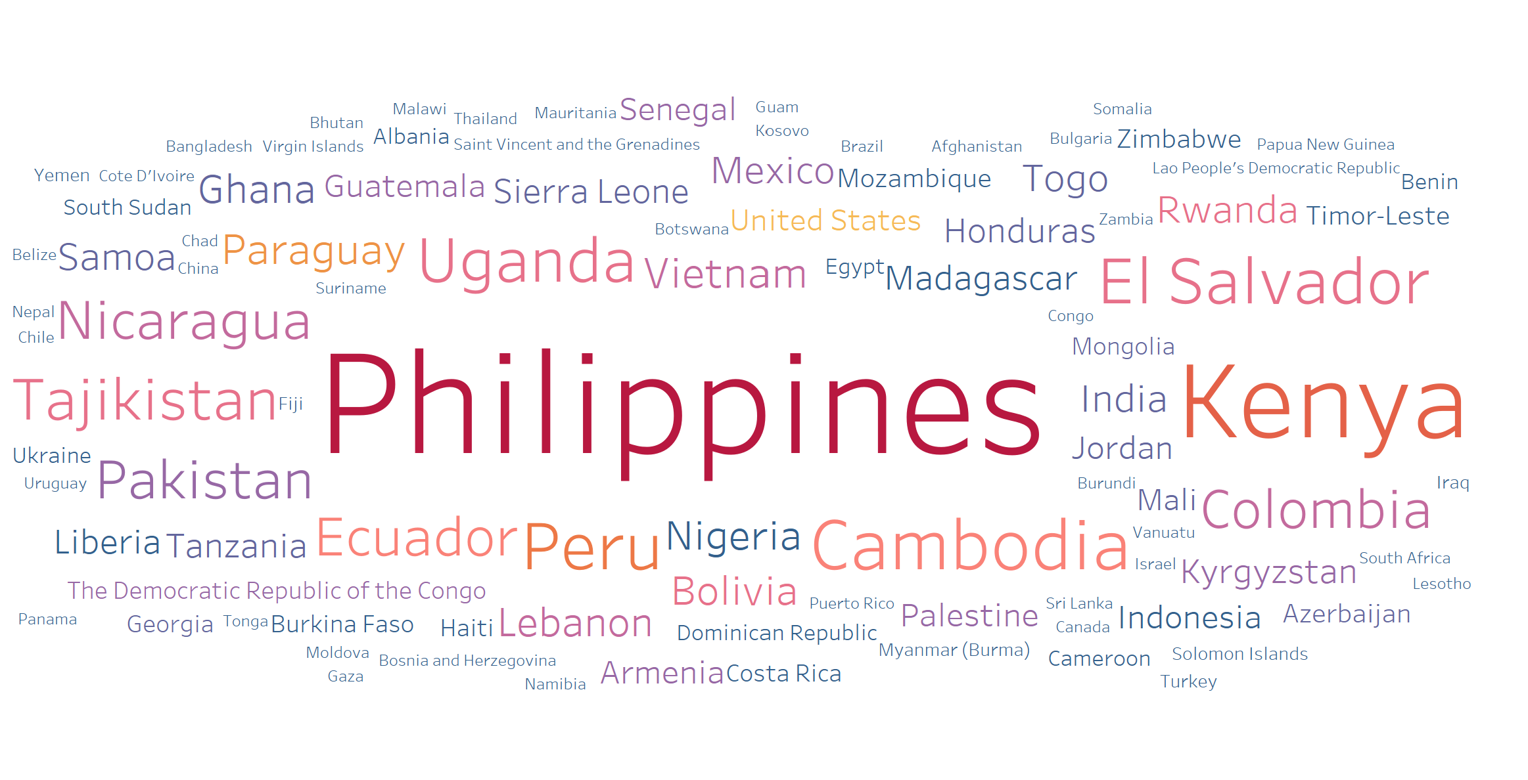
Word cloud in tableau

Slide 30

Thank you

